Slide 1
Tumors
Dr makokha

Slide 2
OUTLINE
Introduction
Classification of Bone tumors
Clinical Presentation
Staging of Bone tumors
Primary Bone tumors
Case Presentation

Slide 3
Introduction
A bone tumor is an abnormal growth of cells within a bone.
The cause of bone tumors is unknown.
They often occur in areas of rapid bone growth. Possible causes include:
1.Genetic defects passed down through families
2.Radiation
3.Injury
Medline plus: Service of U.S national Library of Medicine http://www.nlm.nih.gov/medlineplus/ency/article/001230.htm

Slide 4
Introduction
Cancers that start in the bones are referred to as primary bone tumors.
Cancers that start in another part of the body (such as the breast, lungs, or colon) are called secondary or metastatic bone tumors.
Medline plus: Service of U.S national Library of Medicine http://www.nlm.nih.gov/medlineplus/ency/article/001230.htm

Slide 5
Classification of Bone tumors
Most classifications of bone tumors are based on the dominant tissue in the various lesions.

Slide 6
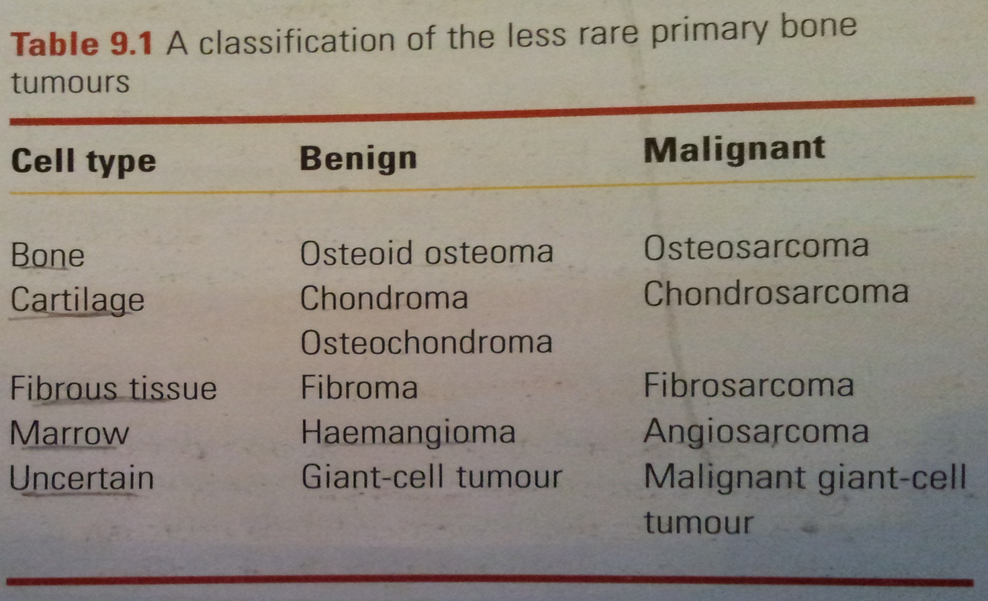
Classification of Bone tumors

Slide 7
Clinical presentation
History
Examination
Imaging
Biopsy
Important differential diagnosis

Slide 8
History
History is often prolonged, results in delay of treatment.
Patients most of the time will be completely asymptomatic until the abnormality is discovered on X-ray.
This is more of benign lesions, common in children and rare after 30
Malignant tumors can be silent if they are slow growing and there is room for expansion like cavity of the pelvis.

Slide 9
History
AGE: Useful clue.
Many benign tumors present during childhood and adolescence
Chondrosarcoma and fibrosarcoma typically occur in 4th and 6th decades adults.
Myeloma rarely seen before 6th decade.
Patients over 70 years metastatic bone lesions are more common than primary tumors.

Slide 10
History
PAIN: common complaint and gives little indication of the nature of lesion.
Progressive and unremitting pain is a very important symptom though.
It may be caused by:
Rapid expansion
Central hemorrhage or degeneration of the tumor
Pathological fracture.

Slide 11
History
Swelling: Appearance of a lump, may be alarming.
Neurological symptoms: Parasthesia and numbness may be caused by pressure or stretching of a peripheral nerve.
Progressive dysfunction is alarming and suggests invasion by an aggressive tumor.

Slide 12
History
Pathological fracture: may be the first and only clinical sign.
In elderly people whose bones usually fracture at the cortico-cancellous junctions, if they get mid shaft fracture it is regarded as pathological until proven otherwise.

Slide 13
Examination
If there is a lump: Where does it arise?
Is it well defined or not?
Soft, hard or pulsatile?
Tender?
Swelling can be diffuse and the overlying skin warm and inflamed which makes it hard to distinguish from infection and hematoma.

Slide 14
Examination
If it is near a joint: is there any movement limitation?
Spinal lesions cause muscle spasm, back stiffness or painful scoliosis.
Examination will focus on symptomatic part but it should include lymph nodes, pelvis, abdomen, chest and spine.

Slide 15
Imaging
X-ray: Most useful of all imaging techniques.
There might be obvious abnormality of the bone:
Cotrical thickening
Discrete lump
Cyst
Ill-defined destruction

Slide 16
Imaging
Soft tissues: are the muscle planes distorted by the swelling? Is there any calcification?
X-ray is not a definitive diagnosis and further investigation must be done to confirm.

Slide 17
Imaging
Other techniques of imaging used are Radinuclide scanning, CT and MRI.
They all help in viewing the lesions better, view soft tissue and detect skip lesions too.
Patient must not go for biopsy if MRI or CT is planned for him as it will distort the image and appearances.

Slide 18
Biopsy
There are three ways:
1.Needle biopsy: Must be performed by experienced personal.
2. Open biopsy: most reliable way of obtaining a representative sample.
3. Excisional biopsy: for benign tumors.

Slide 19
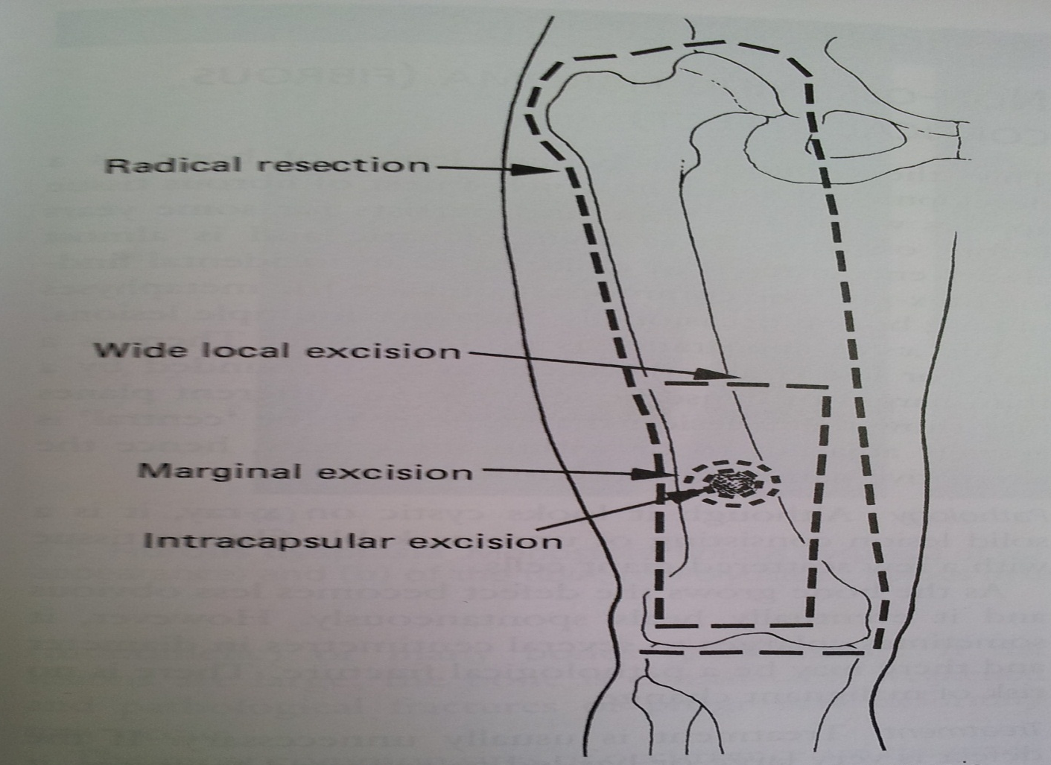
Management

Slide 20
Primary bone tumors
Divided into Benign and Malignant.
They are rare to occur and secondary bone tumors are more common.

Slide 21
Primary Bone tumors
Benign Tumors:
Osteoid Osteoma
Giant cell Tumor
Enchondroma

Slide 22
Primary Bone tumors
Malignant tumors:
Multiple myeloma
Osteosarcoma
Ewing’s sarcoma
Chondrosarcoma

